Slide 1
Rec-user: Recommending Users for GitHub Projects
Raunak Sinha
Akarsha Sehwag
Hridoy Sankar Dutta

Slide 2
Problem Statement
Github - collaborative social network for programmers.
Problem Statement: Recommending GitHub Users for GitHub Projects based on activities in GitHub and StackOverflow
Solution: Creating user features based on activities performed in GitHub and StackOverflow and recommending the projects the matched GitHub users for them.

Slide 3
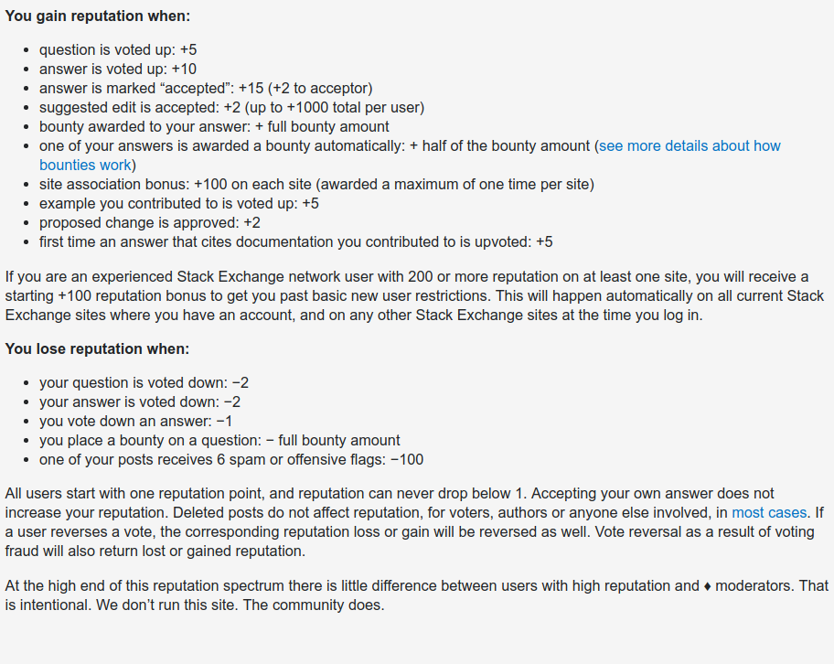
Dataset Description
We had a list of common GitHub ID’s and StackOverflow ID’s.
From GitHub API, we extracted the languages of the repositories a particular user has contributed to.
For StackOverflow(SO) Dump, we extracted the following features:
Reputation of a particular user
Number of Questions with 0 answers
Number of Questions with atleast 2 answers
Score of a user (Total Upvotes-Downvotes count for all his/her questions/answers)
Fig. Reputation calculation in StackOverflow

Slide 4
Dataset Summary
GitHub & StackOverflow Common Users | 1936
StackOverflow Users Features Extracted | 4
GitHub Repositories Features Extracted | 256
Github User Features Extracted | 256

Slide 5
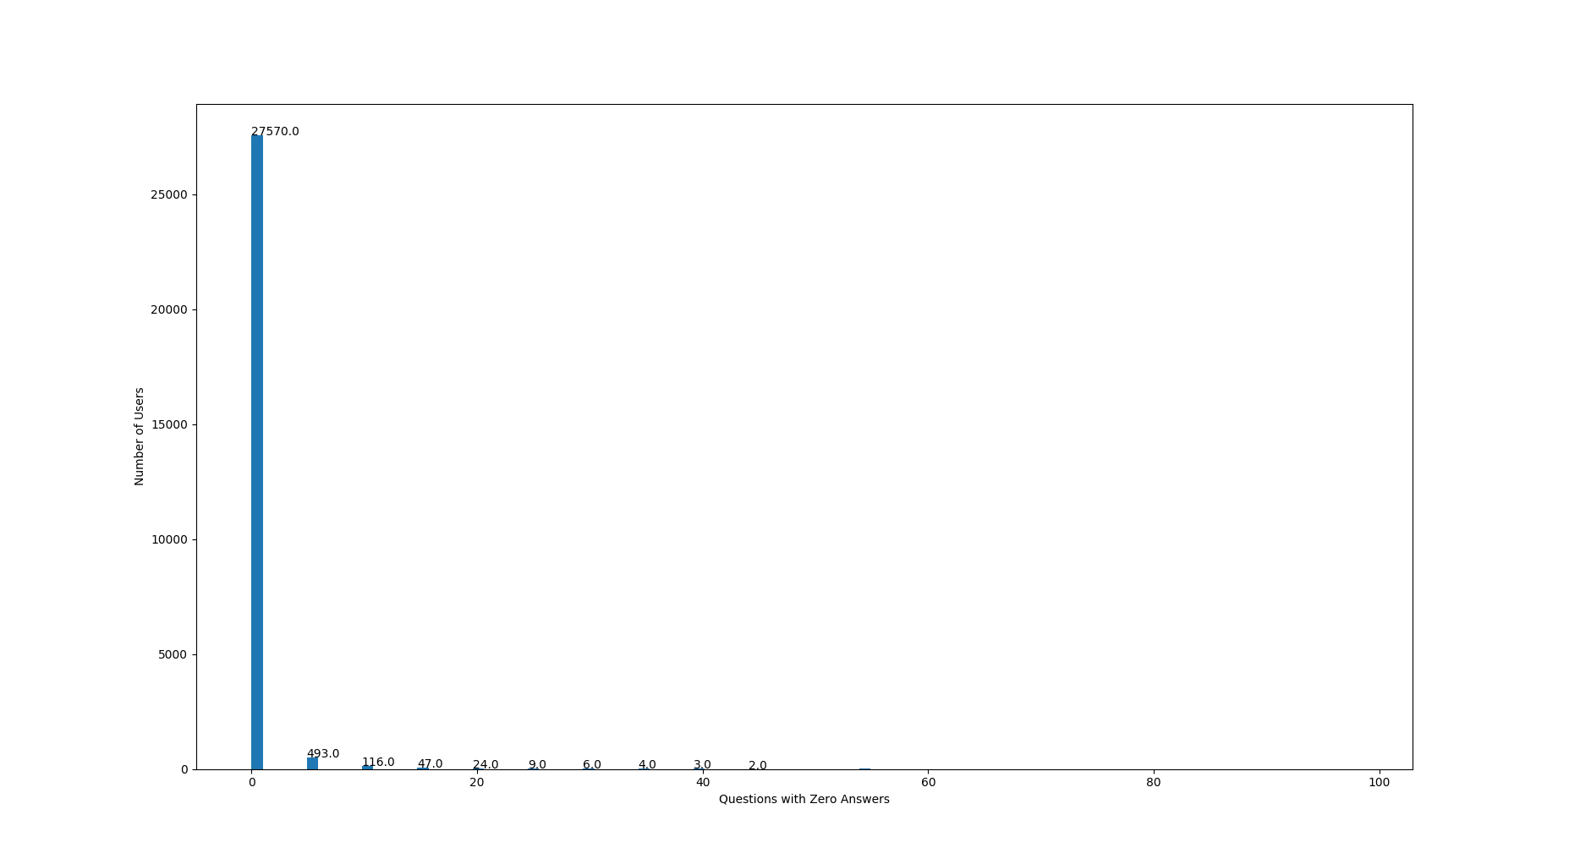
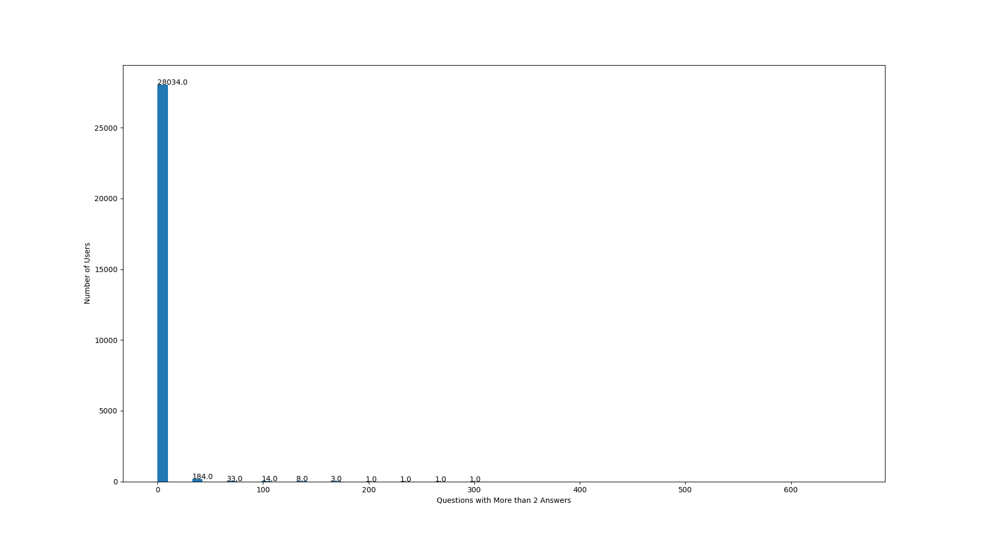
Data Analysis from StackOverflow

Slide 7
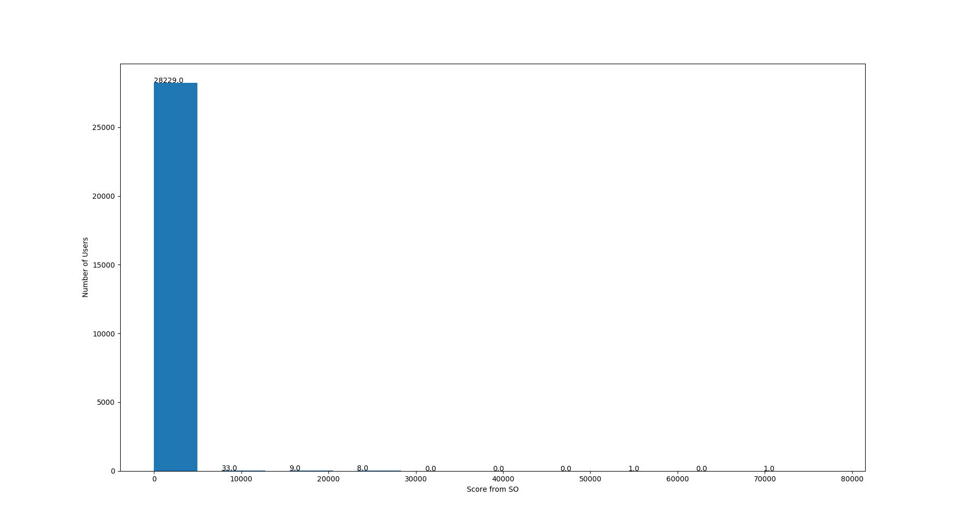

Slide 8
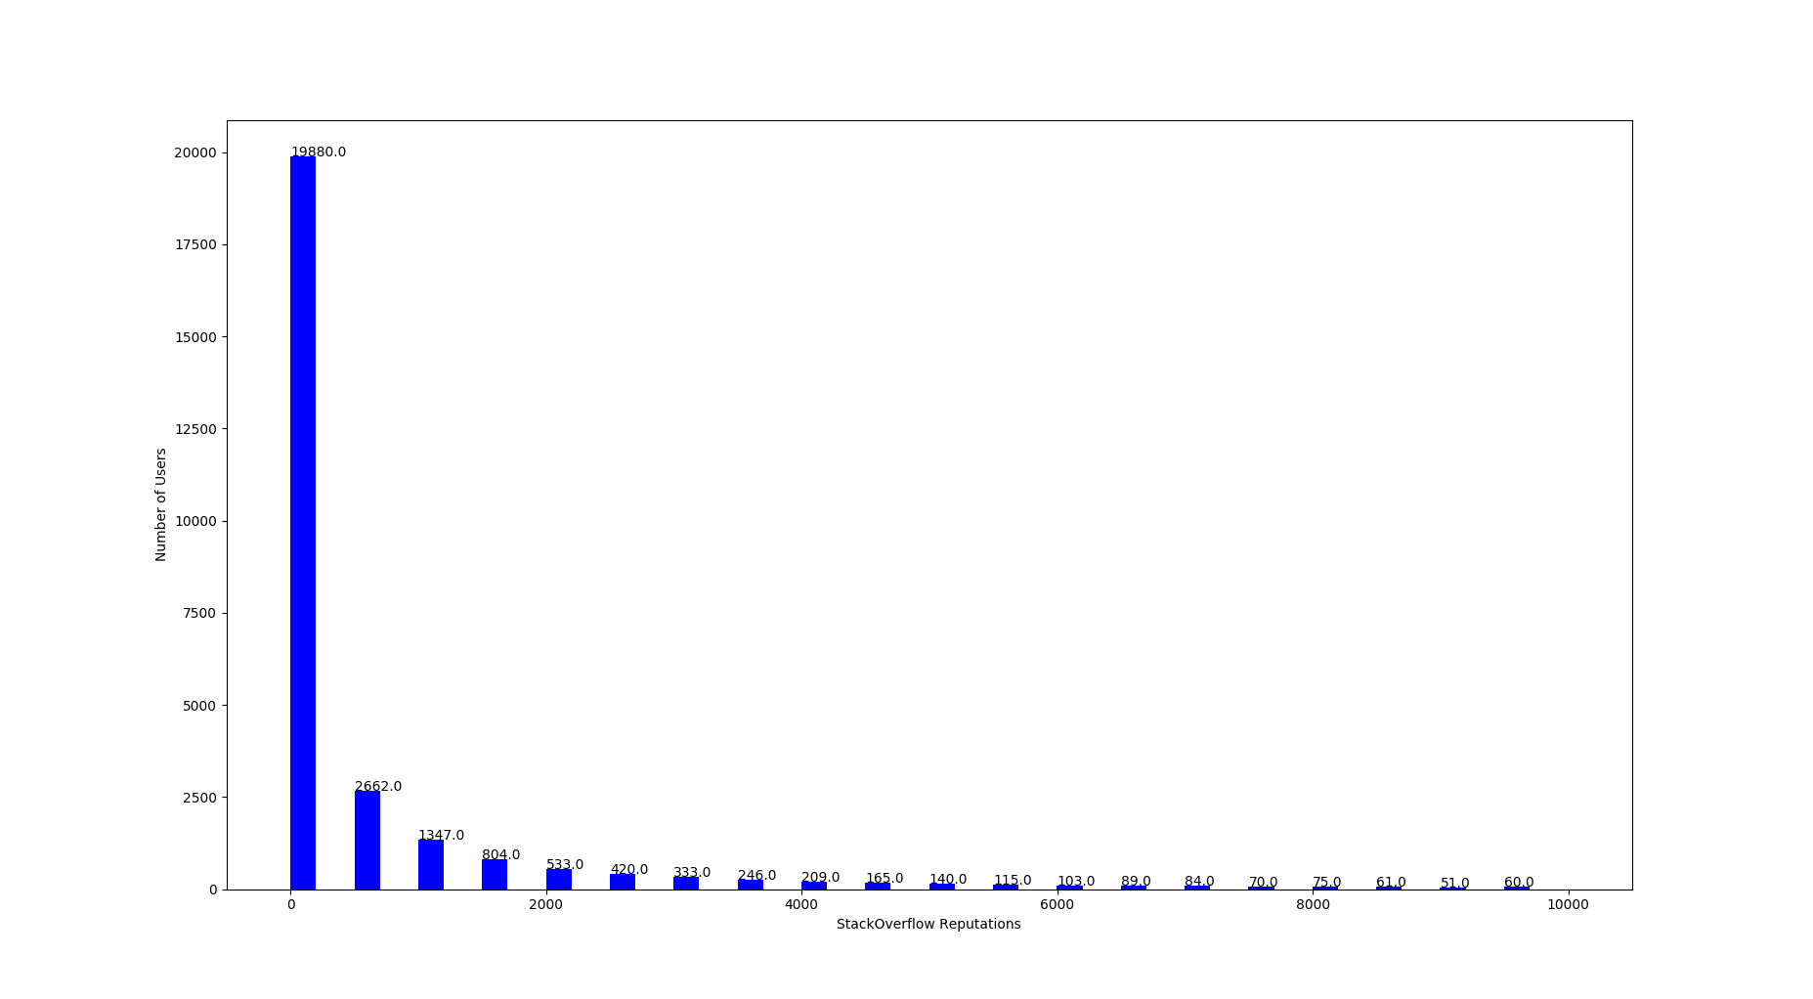

Slide 9
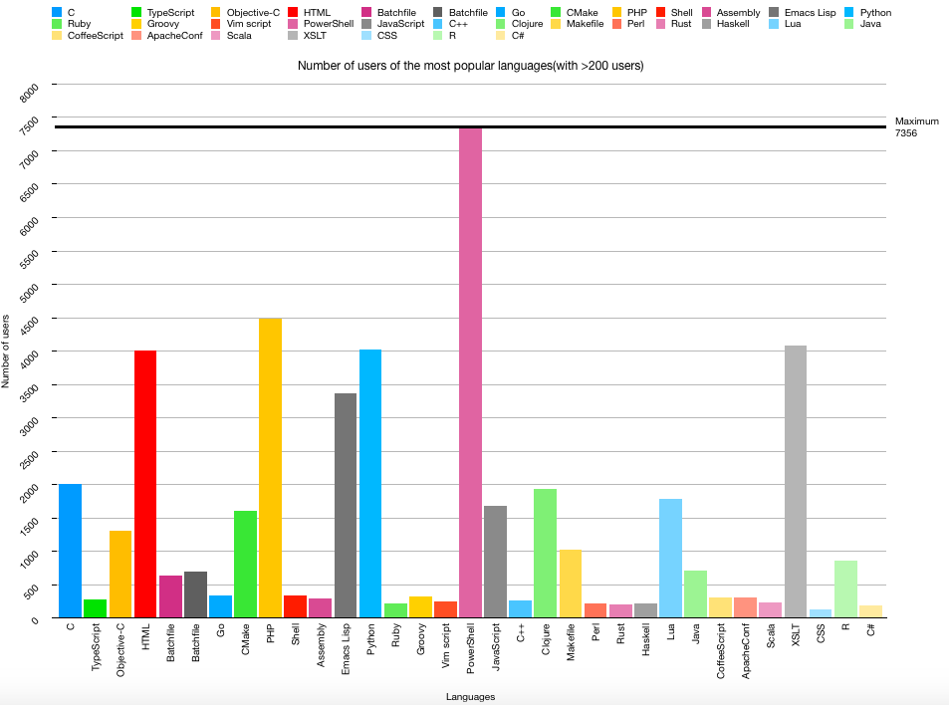
Data Analysis from GitHub

Slide 10
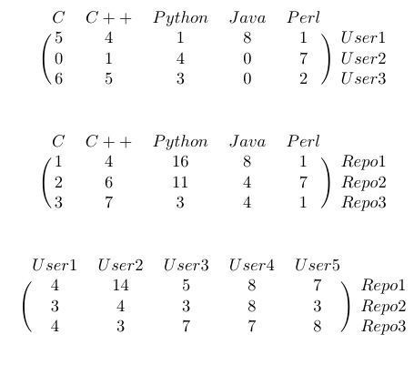
User-Item Recommendation using LightFM
A hybrid matrix factorisation model for linear combinations of their latent factors to recommend the best possible match user for a particular user.
A collaborative filtering model, users and items are represented as latent vectors (embeddings)
Works with three sets of information, user metadata, repository metadata and interactions between them.

Slide 11
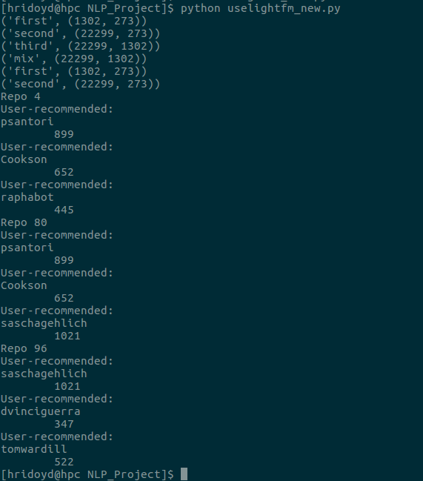
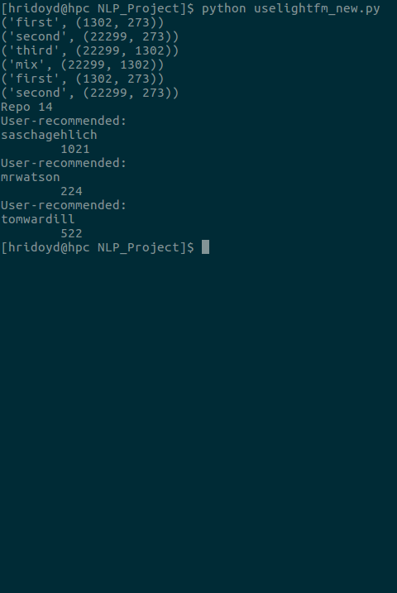
Recommendation using LightFM

Slide 12
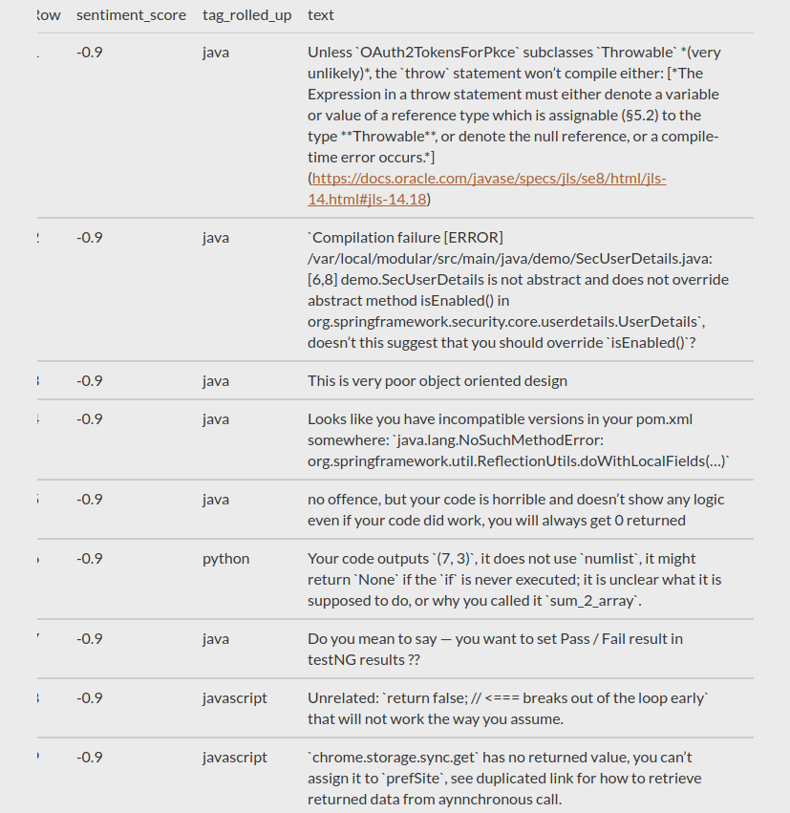
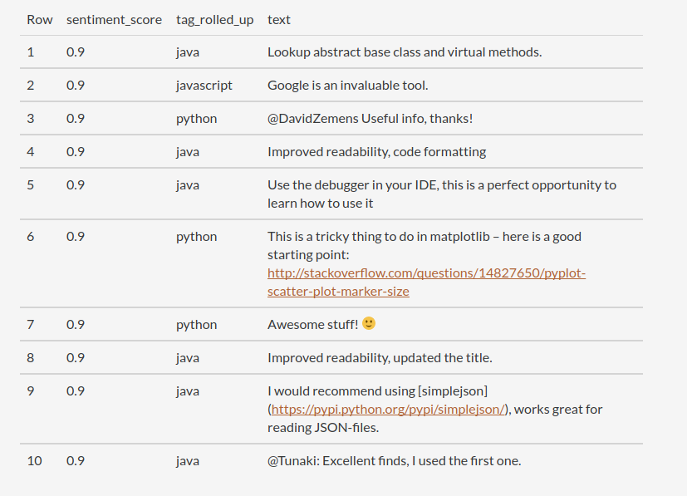
Present Work
Sentiment Analysis (language-wise) on posts posted by different StackOverflow users. (not completed due to infrastructure limitations)
For each user, the user posts questions/answers based on a some tags (HTML, Python).
We calculate average polarity (emotions in a sentence) and subjectivity (some personal feelings, views or beliefs) by performing sentiment analysis on the post data.
We perform sentiment analysis by eliminating the text inside the <code></code> section.

